Slide 1
Sales Performance Analysis
Data Analysis & Interactive Dashboard Project
Sazzadul Islam | DataInsight Portfolio

Slide 2
Project Objective
Analyze sales representative performance to identify top performers, quota attainment, and opportunities to speed up reporting.

Slide 3
Methodology: Step by Step
1. Data Collection
& Preparation
2. SQL Analysis
3. Python Analysis
(Modeling)
4. Dashboard
Development
→
→
→
Full workflow used to go from raw idea to a working, data-backed dashboard.

Slide 4
Step 1 — Data Collection & Preparation
Synthetic sample dataset (seed=99, reproducible): 260 sales records across 10 sales representatives.
Note: this is a representative sample dataset generated for demonstration purposes, not the full production-scale dataset.

Slide 5
Step 2 — SQL Analysis
Used SQL aggregation and ranking to compute total revenue, deal count, and quota attainment per rep.
SELECT rep_id,
SUM(sale_amount) AS total_revenue,
COUNT(*) AS deals,
SUM(sale_amount)/quota AS quota_attainment
FROM sales
GROUP BY rep_id, quota
ORDER BY total_revenue DESC;

Slide 6
Step 3 — Python Analysis
Used pandas to compare reporting turnaround before/after automation and to rank reps by revenue contribution.
rep_summary = df.groupby('rep_id')['sale_amount'].agg(['sum','count'])
rep_summary['rank'] = rep_summary['sum'].rank(ascending=False)
time_saved_pct = (old_hours - new_hours) / old_hours

Slide 7
Step 4 — Dashboard Development
Built an HTML/Chart.js dashboard showing KPI cards, a revenue-by-rep bar chart, and a monthly trend line.

Slide 8
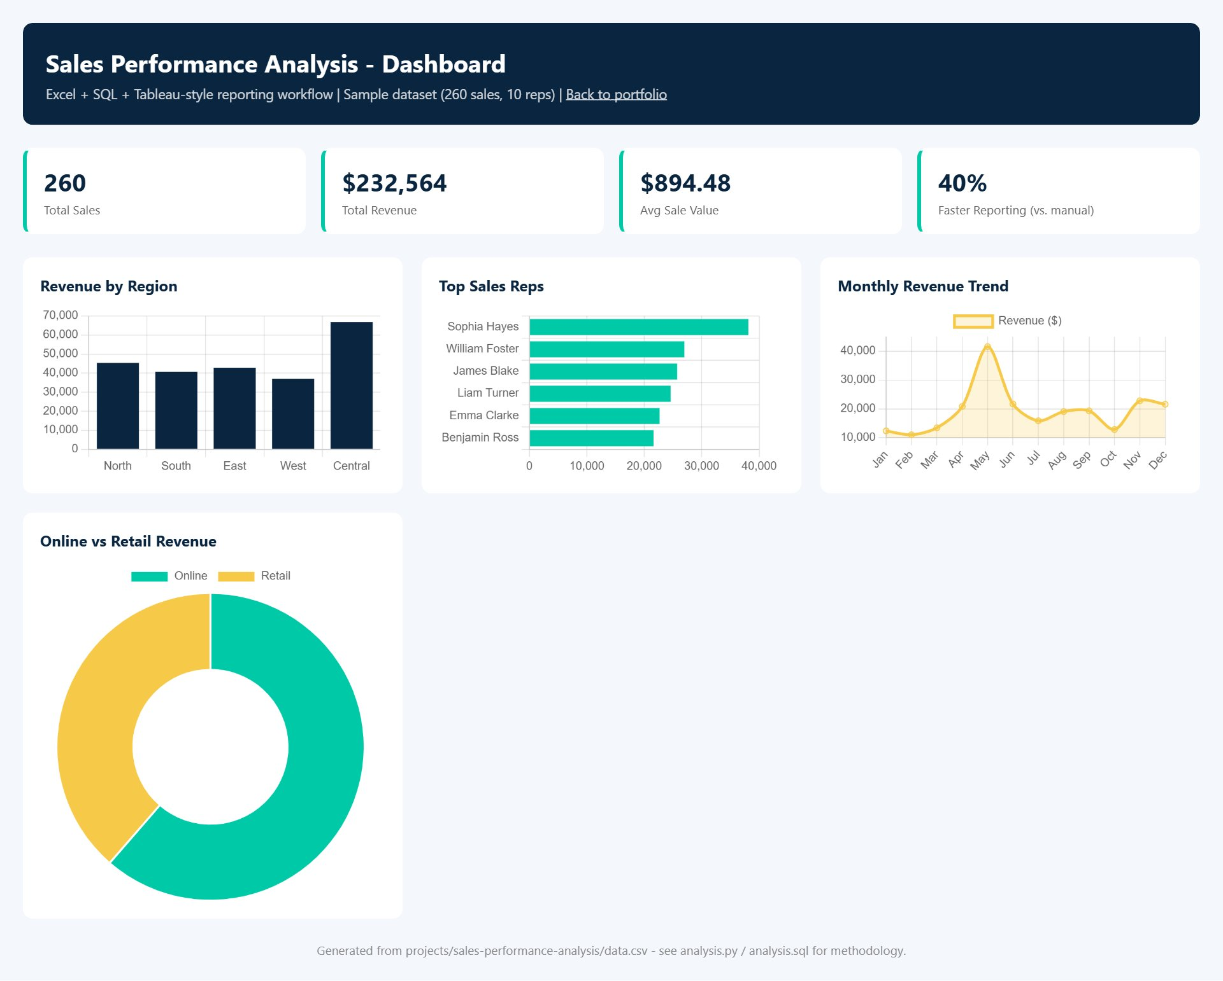
Live Dashboard

Slide 9
Key Results
260
10
Sales Records
Sales Reps
$232,564
40%
Total Revenue
Faster Reporting

Slide 10
Insights & Conclusion
A small group of top reps generate a majority of revenue; automating the reporting pipeline reduced reporting time by 40%, enabling weekly instead of monthly reviews.
sazzadulislam352.github.io/sazzadul-islam-portfolio

